Slide 1
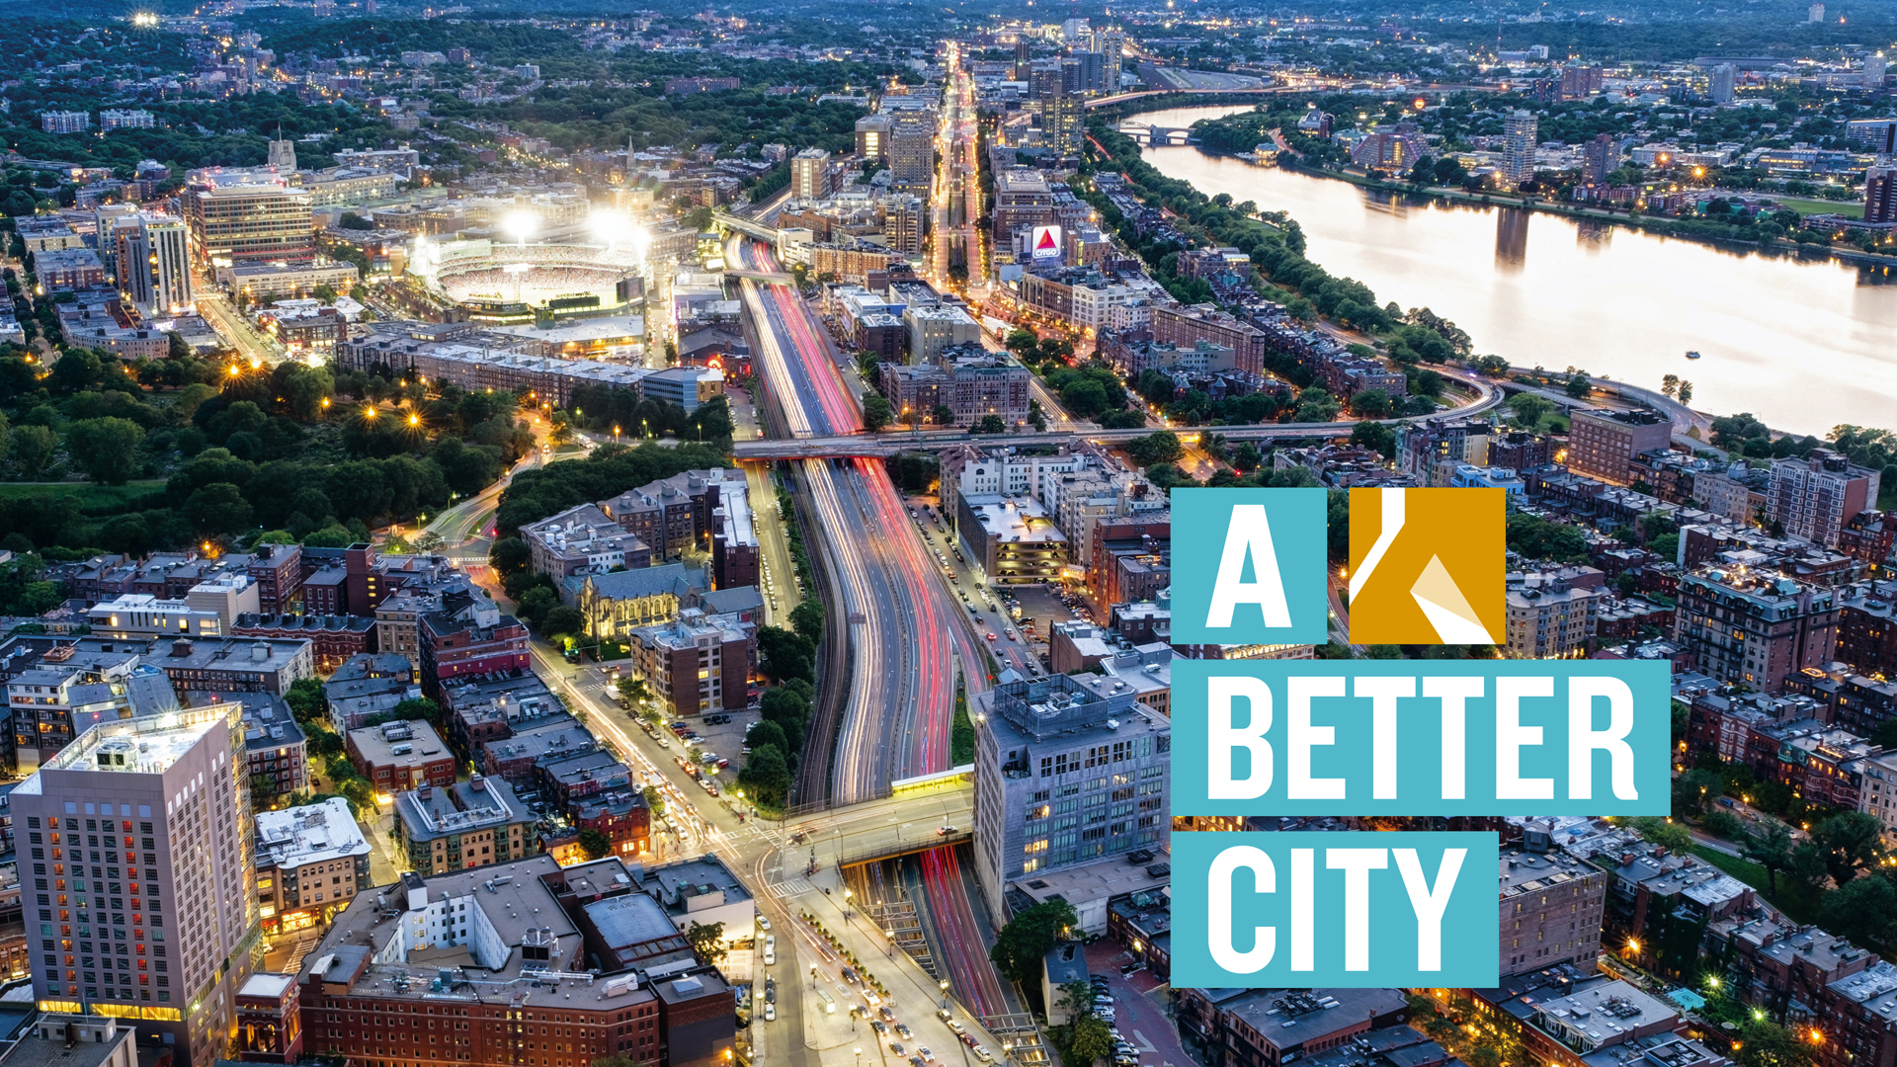
MBTA Safety, Service, Staffing
2023 Year in Review

Slide 2
2023 year In review
MBTA safety, service, staffing
Safe and reliable public transit service is essential to the economic vitality of the region—and to reaching our climate, equity, and mobility goals
To meet the current and future needs of our riders and our economy,
the MBTA must address major safety, service, and staffing challenges

Slide 3
Safety, Service, Staffing
Years of Underinvestment and System Neglect
  Operating and capital budgets stressed
  State of Good Repair estimate doubles in less than 5 years reaching $24Billion
Safety and Safety Culture Challenges
  Federal Transportation administration safety management inspection
  Safety culture
Policy and Procurement Decisions
  CRRC Orange and Red Line contract
  Forging Ahead

Slide 4
Snapshot: Safety, Service, Staffing
In 2023, A Better starts tracking key performance metrics and data trends using publicly available data and reporting to members
Safety: FTA Response, Speed Restrictions,
Service: Service levels, Ridership,
Staffing: General Trends, Bus and Operations Control Center Hiring

Slide 5
Safety
Federal Transit Administration (FTA) Safety Management Inspections Uncovers Broad, System, Safety Issues
Governor Healey appointments new General Manager, Phil Eng (former LIRR) (Joins in April 2023)
Senior safety and infrastructure appointments
    Doug Connett, Chief of Infrastructure
    Sam Zhou, Assistant General Manager of Engineering and Capital
    Rod Brooks, Senior Advisor for Capital, Operations, and Safety
    Dennis Varley, Chief of Stations
https://www.mbta.com/news/2023-07-27/four-transit-veterans-appointed-new-mbta-leadership-will-oversee-stations

Slide 6
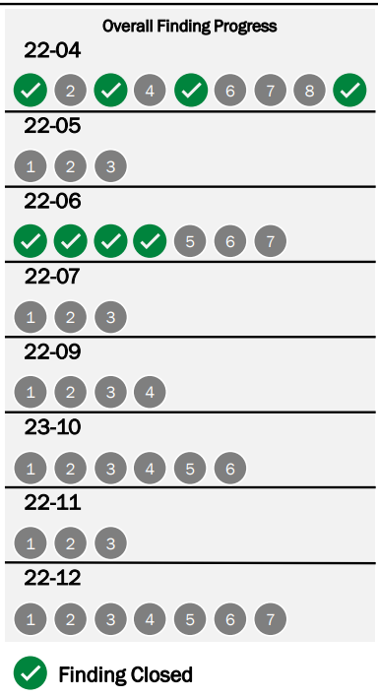
FTA Safety Management Inspection response Advances in 2023
FTA Safety Management Inspection Report, August 2022
8 Special Directives; 42 findings
To date, 8 closed; 34 ongoing
Monthly updates on MBTA website
MBTA projects substantial progress in 2024
Forecast shows 35 findings closed; 7 ongoing by 12/31/2024
https://cdn.mbta.com/sites/default/files/2024-01/1.%20QCO%20Update%20Jan%20Board%202024.pdf
https://www.mbta.com/quality-compliance-oversight/fta-safety-management-inspection-response

Slide 7
MBTA Makes steady progress in 2023 to address speed restrictions
Department of Public Utility safety finding March 2023
  Systemwide Slow Zones imposed
  (10 to 23 mph) and triggers targeted track work
  MBTA Launches Speed Restriction Dashboard
  Track work begins
Substantial gains on Green Line and Red Line
2024 Track Improvement Plan launched
https://www.mbta.com/performance-metrics/speed-restrictions

Slide 8
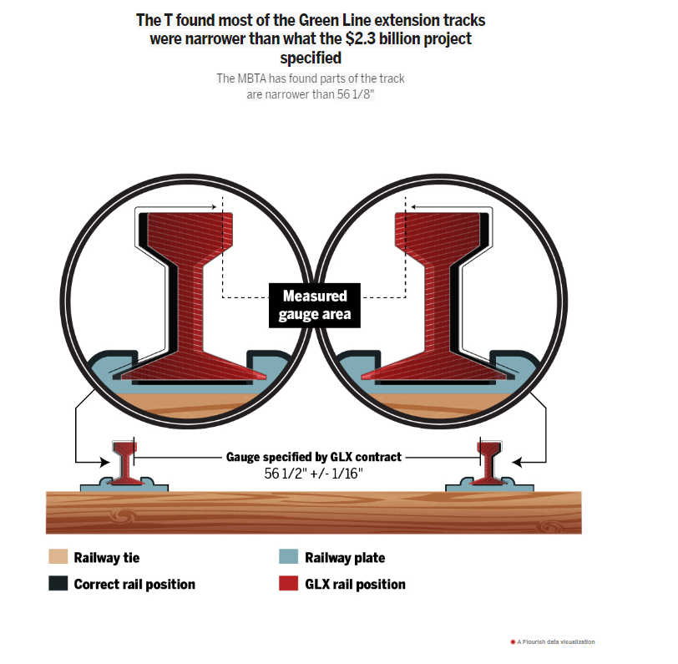
Spotlight: Green Line Extension
As early as 2021, GLX tracks found narrower than project specifications—up to 3/8 of an inch off—no substantial remediation prior to opening, problem left unaddressed
  Guage is the distance from the inside of the two rails
June 2023, the slow zones implemented on 600 feet of the GLX, impacting both branches, slowing trains down to 3 miles an hour―walking pace
By September 2023, slow zones made up more than 12% of GLX track (totaling more than 1 mile)
GLX “fix” took longer than expected. According to the MBTA, In January 2024, track work completed, alleviating all current tight gauge conditions along both Green Line Extension branches
https://www.bostonglobe.com/2023/12/21/metro/mbta-green-line-extension-issues/

Slide 9
Service
Service in 2023 is still below pre-pandemic levels
  Speed restrictions and ongoing track work continue to impact service levels
  Workforce challenges (bus operator, Operations Control Center [OCC] Dispatchers) aggravate stresses
  Delayed delivery of Orange and Red Line cars present rolling stock issues

Slide 10
Travel Times fluctuate in 2023
https://www.mbta.com/performance-metrics/speed-restrictions

Slide 11
Travel Time Savings
March
Blue Line: High of 27 mins in March ending the year at 22 mins saving 5 mins
March
Orange Line: High of 49 mins in March ending the year at 43 mins saving 6 mins
August
Red Line:
Ashmont: High of 66 mins in August ending the year at 52 mins saving 14 mins
Braintree: High of 86 mins in March ending the year at 69 mins saving 17 mins
Source: https://dashboard.transitmatters.org/

Slide 12
Update: Orange & Red Line Cars
Senior level integrated management team established to get work back on track. Team meets twice daily and once weekly in Springfield to discuss production progress.
CRRC promises to deliver 2 married Orange Line pairs per month.
CRRC Delivered 26 Orange Line Cars and 4 Red Line Cars in 2023.
Total delivery (to date): 110 Orange Line Cars; 18 Red Line Cars
MBTA still in contract discussions with CRRC
New inspection process in place with new hires within the CRRC Quality Assurance Team
High-level meeting (8/16/23) with CRRC Chairman, Secretary Fiandaca, Economic Development Secretary Hao, Undersecretary Tibbits-Nutt, General Manager Eng
https://cdn.mbta.com/sites/default/files/2023-08/GM%20Report%20to%20Board%2008.24.2023%20v3.pdf

Slide 13
Ridership rebounds unequally
Subway Systemwide Average Weekday:
  54% of pre-pandemic levels; 7% higher than 2022
Subway Systemwide Average Weekend:
  72% of pre-pandemic; 6% higher than 2022
Commuter Rail Systemwide Average Weekday:
  74% of pre-pandemic levels; 39% higher than 2022
Commuter Rail Systemwide Average Weekend:
  33% higher in 2022

Slide 14
Weekday Subway Ridership in 2023
Blue Line: 75% of pre-pandemic levels; 27% higher than 2022
Green Line: 63% of pre-pandemic levels; 12% higher than 2022
Orange Line: 50% of pre-pandemic levels; 13% higher than 2022
Red Line: 46% of pre-pandemic ridership levels; 5% lower than 2022
Systemwide: 54% of pre-pandemic levels; 7% higher than 2022

Slide 15
Weekend Subway Ridership in 2023
Blue Line: 85% of pre-pandemic levels; 28% higher than 2022
Green Line: 81% of pre-pandemic levels; 8% higher than 2022
Orange Line: 72% of pre-pandemic levels; 15% higher than 2022
Red Line: 58% of pre-pandemic ridership levels; 12% lower than 2022
Systemwide: 72% of pre-pandemic; 6% higher than 2022

Slide 16
Commuter Rail Ridership rebounds
https://mbta-massdot.opendata.arcgis.com/datasets/MassDOT::mbta-commuter-rail-ridership-by-service-date-and-line/explore

Slide 17
Commuter Rail Ridership
Average weekday ridership (systemwide) in 2023 was 75% of pre-pandemic levels
Highest ridership in October 2023 reaching 90% of pre-pandemic levels
https://mbta-massdot.opendata.arcgis.com/datasets/MassDOT::mbta-commuter-rail-ridership-by-service-date-and-line/explore

Slide 18
Staffing
External hires (1,480) up 78% from 2022
Internal promotions (511) up 7% from 2022
Separations (750) 13% higher in 2022, but 53% hire in 2022 compared to 2021
Collective bargaining agreement with Local Carmen’s 589 increasing bus operator salaries
Collective bargaining agreements with 7 other unions

Slide 19
Current active Bus Operator Trainees: 124
Vacancies less Trainees: 151

Slide 20
Operations Control Center Dispatcher Status
The data includes Heavy Rail, Light Rail, and Bus Dispatchers, as well as Dispatchers who are on leave. It does not include Spare Dispatchers.
Total Full Time Dispatchers: 55
(26 Heavy Rail, 12 Light Rail, 17 Bus)
Budgeted Headcount: 72
(30 Heavy Rail, 15 Light Rail, 27 Bus)
Dispatcher Vacancies: 17
(4 Heavy Rail, 3 Light Rail, 10 Bus)
Notes:
Below is the current headcount for OCC Dispatchers as of 2/20/24

Slide 21
Questions?

Slide 22
THANK YOU

Slide 23
Sumner Tunnel Closure
#Ditchthedrive effective
Commuter Rail
Zone 1A Fares Newburyport/Rockport Line
Blue Line
Free Blue Line
Service Delivery Improvements
Ferry
New Ferry Routes
Service Delivery Improvements
Free/Reduced Fare
Parking
Free or Reduce Parking at Select MBTA Lots
Communication and Outreach
Traffic Impacts
Mitigation Options
Bus
Free 111 Bus
Service Delivery Improvements

Slide 24
Fare policy induces demand
  31% & 89% increase in average weekday ridership in July & August 2023 compared to 2022
    10% more riders in July 2023 compared to June 2023
    12% more riders in August 2023 than July 2023.
https://mbta-massdot.opendata.arcgis.com/datasets/MassDOT::mbta-commuter-rail-ridership-by-service-date-and-line/explore

Slide 25
Fare policy promotes mode shift
42% and 44% increase in average weekday ridership July and August 2023 compared to July and August 2022
41% and 46% increase in average weekend ridership July and august 2023 compared to July and august 2022
https://massdot.app.box.com/s/21j0q5di9ewzl0abt6kdh5x8j8ok9964?sortColumn=date&sortDirection=DESC

Slide 26
Major increase at airport station
59% & 70% increases in weekday ridership at Airport Station in July and August 2023
45% & 61% increase in weekend ridership at Airport Station in July and August 2023
https://massdot.app.box.com/s/21j0q5di9ewzl0abt6kdh5x8j8ok9964?sortColumn=date&sortDirection=DESC

